Slide 1

Content-Based Retrieval (CBR)
-in multimedia systems
Presented by: Chao Cai
Date: March 28, 2006
C SC 561
Notes:
Good Morning! My name is Chao.
Today I like to give a topic on “Content-Based Retrieval” which so called “CBR” in multimedia systems.

Slide 2
Outline
Content-Based Retrieval (CBR)
Content-Based Image Retrieval (CBIR)
Content-Based Video Retrieval (CBVR)
Content-Based Audio Retrieval (CBAR)
My Proposals
Notes:
Here is an outline for my presentation.
I am gonna talk about what is content-based retrieval CBR.
I am gonna introduce three major content-based retrieval in multimedia systems, which are CBIR, CBVR and CBAR.
And if time allows, I will briefly mention my proposals to effective CBR.

Slide 3
What is Content-Based Retrieval (CBR) ?
Content-Based Retrieval (CBR)
  Digital Library
  Contents contained in digital text, sound, music, image, video, etc
  Serve as a browsing tool
  Keyword indexing is fast and easy to implement. However, it has limitations.
    Can’t handle nonspecific query, “Find scenic photo of Uvic”
    Misspelling is frequent and difficult, “azalia” for “azalea”
    Descriptions are often inaccurate and incomplete
Notes:
So first of all, what is content-based retrieval?
We are experiencing an evolution from small databases, to image databases, ..., and now onto to Digital Library. A digital library is a library in which resources are available in machine-readable format as opposed to print accessible by means of computers. Digital Library is essential to CBR, it is a repository enables content-based retrieval.
Contents contained in digital text, sound, music, image, video, etc. A big step forward from traditional database search which is largely based on simple attributes.
CBR systems Serve as a browsing tool – just like the current web search for example google as we all familiar
Keyword indexing is fast and easy to implement, and this is what we have been doing so far and we are quite expert on it. However, when it comes to multimedia data it has limitations:
Can't handle nonspecific queries such as "Find a scenic photo of Uvic"
Misspelling is frequent and difficult, e.g., "azalia" for "azalea"
Descriptions are often inaccurate and incomplete

Slide 4
Content-Based Image Retrieval (CBIR)
How can images be described automatically so that they can be compared efficiently and effectively, and in a way that can be considered useful from a user perspective?
… and a possible solution
A quantitative definition of effectiveness, and a complete statistical analysis of the image descriptors and of their possible comparison strategies.

Slide 5
Retrieval by Similarities
- Color Similarity
Color Similarity:
Color distribution similarity has been one of the first choices because if one chooses a proper representation and measure it can be partially reliable even in presence of changes in lighting, view angle, and scale.
RED
YELLOW
YELLOW
BLUE
BLUE
RED
Notes:
In Image 1, the top left quarter (25%) is red, the bottom left quarter (25%) is blue, and the right half (50%) is yellow. In Image 2, the top right quarter (25%) is blue, the bottom right quarter (25%) is red, and the left half (50%) is yellow.
So the 2 images have complete similarity (score = 0.0), because each color (red, blue, yellow) occupies the same percentage of the total image in each one.

Slide 6
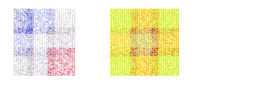
Retrieval by Similarities
- Texture Similarity
Texture Similarity:
Texture reflects the texture of entire image.
Texture is most useful for full images of textures, such as catalogs of wood grains, marble, sand, or stones.
Texture images are generally hard to categorize using keywords alone because our vocabulary for textures is limited
Wold Decomposition
  Periodic
  Evanescent
  Random
Notes:
Wold decomposition of the texture considered as a luminance field. One gets three components(periodic, evanescent and random) corresponding to the bi-dimensional periodicity, mono-dimensional orientation, and complexity of the analyzed texture. Experiments have shown that these independent components agree well with the perceptive evaluation of texture similarity.

Slide 7

Retrieval by Similarities
- Shape Similarity
Shape Similarity:
Shape represents the shapes that appear in the image.
Shapes are determined by identifying regions of uniform color.
Shape is useful to capture objects.
Shape is very useful for querying on simple shapes.
Notes:
Shape represents the shapes that appear in the image.
Shapes are determined by identifying regions of uniform color.
Shape is useful to capture objects such as horizon lines in landscapes, rectangular shapes in buildings, and organic shapes such as trees.
Shape is very useful for querying on simple shapes (like circles, polygons, or diagonal lines) especially when the query image is drawn by hand and color is not considered important when the drawing is made.
The two images shows two images very close in shape.

Slide 8
Retrieval by Similarities
- Spatial Similarity (1)
Spatial Similarity:
  Symbolic Image
  Spatial similarity assumes that images have been segmented into meaningful objects, each object being associated with is centroid and a symbolic name. This representation is called a symbolic image.
  Similarity Function
  It is relatively easy to define similarity functions for such image modulo transformations such as rotation, scaling and translation.

Slide 9
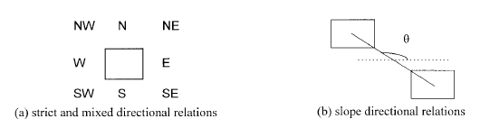
Retrieval by Similarities
- Spatial Similarity (2)
Directional Relations
Notes:
The frequently used directional relations are the strict directional relations: north, south, east, and west.
Another directional relation specifies the directional relation between two objects as the slope of the line joining their centroids, called slope directional relations.
However, directional relations have its limitation as it ignores an object’s spatial extent, hence we introduce another relation.

Slide 10
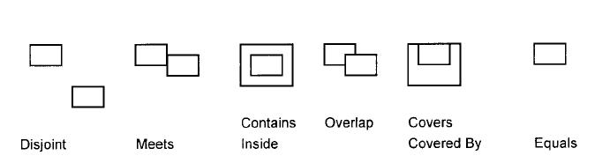
Retrieval by Similarities
- Spatial Similarity (3)
Topological Relationship
Notes:
Topological relations, on the other hand, always exist between any two objects. Also, topological relations are mutually exclusive, i.e., there is one and only one topological relation between any two objects in an image. Another interesting feature of topological relations is that they are preserved under perfect translation, scaling, or rotation transformations.

Slide 11
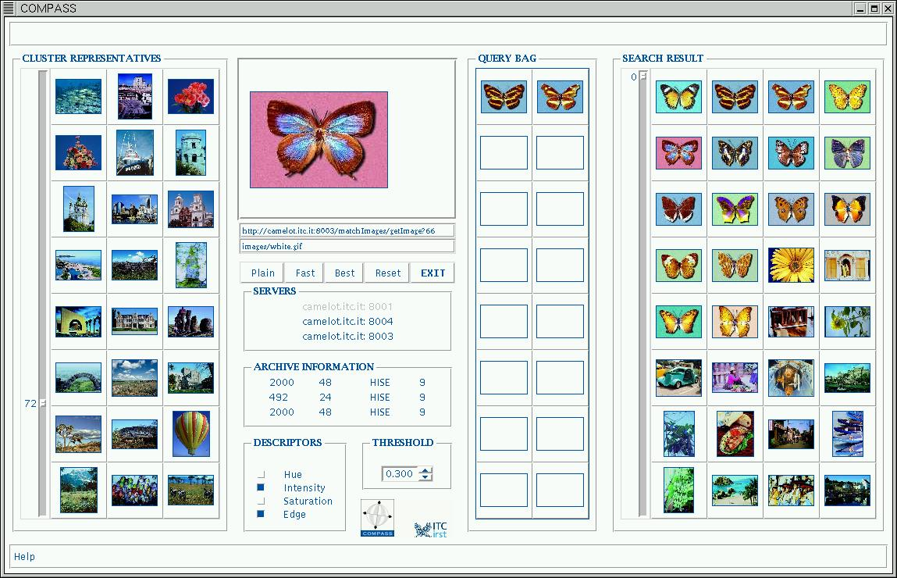
COMPASS
Notes:
COMPASS is a distributed application for content-based image retrieval using remote databases. The COMPASS system can be used for two main activities: to browse still image databases, and to search image databases similar to a query image. Therefore, the user formulates queries by examples and not a mere caption textual search.

Slide 12
Content-Based Video Retrieval(1) (CBVR)
Spatial Scene Analysis
Color Feature Space
Color is an important cue for measuring the similarity between visual documents.
Texture Feature Space
The analysis of textures requires the definition for a local neighborhood corresponding to the basic texture pattern.
Supervised Feature Space
More complex features may be defined for parsing the contents of a video document. i.e Face Detection, Text Annotation.
Notes:
Content-based Video Retrieval (CBVR) systems appear like a natural extension (or merge) of Content-based Image Retrieval (CBIR) systems. However, there are a number of factors that are ignored when dealing with images which should be dealt with when using videos. These factors are primarily related to the temporal information available from a video document.
Visual document processing operations are essential for automatically extracting an extensive description of a document. Feature extraction aims at characterizing a list of properties (called feature vector or document signature) for each component (pixel, frame region, frame, sequence) of a video document.

Slide 13
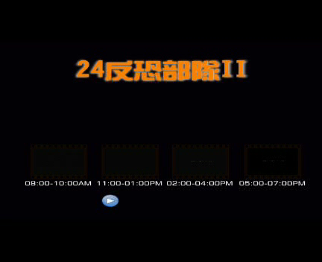
Content-Based Video Retrieval(2) (CBVR)
Temporal Analysis
Levels of Granularity:
  Frame-Level
  Short-Level
  Scene-Level
  Video-Level
Types of Shot-Level:
  Cut
  Dissolve
  Wipe
Notes:
Spatial Scene Analysis on video can be fully transferred from CBIR. But Temporal analysis is the uniqueness about video. Temporal Information induces the concept of motion for the objects present in the document.
The temporal analysis of that document typically requires its partitioning into basic elements recognized at four different levels of granularity:
Frame level: Each frame is treated separately. There is no temporal analysis at this level.
Shot-level: A shot is a set of contiguous frames all acquired through a continuous camera recording. Only the temporal information is used.
Scene-level: A scene is a set of contiguous shots having a common semantic significance.
Video-level: The complete video object is treated as a whole.
From which Shot-Level is the most concerned basic element, three types:
Cut: A sharp boundary between shots. This generally implies a peak in the difference between color or motion histograms corresponding to the two frames surrounding the cut.
Dissolve: The content of last images of the first shots is continuously mixed with that of the first images of the second shot.
Wipe: The images of the second shot continuously cover or push out of the display that of the first shot.

Slide 14
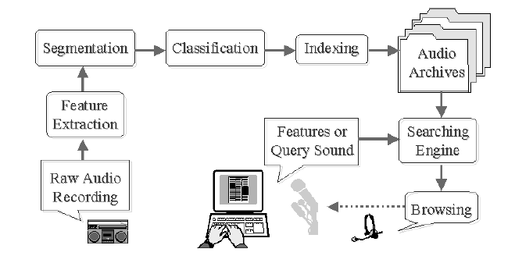
Content-Based Audio Retrieval (CBAR)
Notes:
I will give an example procedure of how audio is retieved from the system: Raw audio recordings are analyzed and segmented based on abrupt changes of features. Then, audio segments are classfied and indexed. They are stored in corresponding archives. When a user wants to browse the audio samples in the archives, he may put a set of features or a query sound into the computer. The search engine will then find the best matched sounds and present them to the user. The user may also refines the query to get more audio material relevant to his interest.

Slide 15
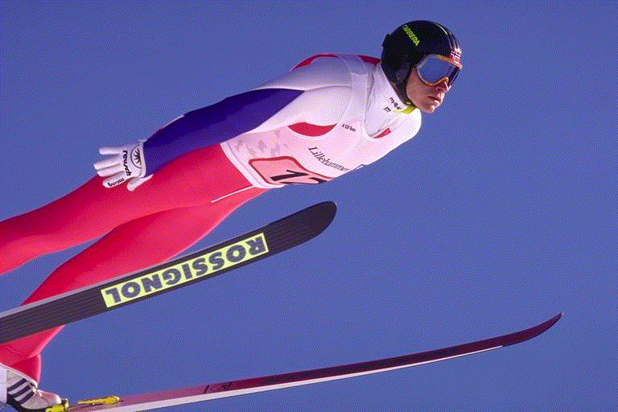
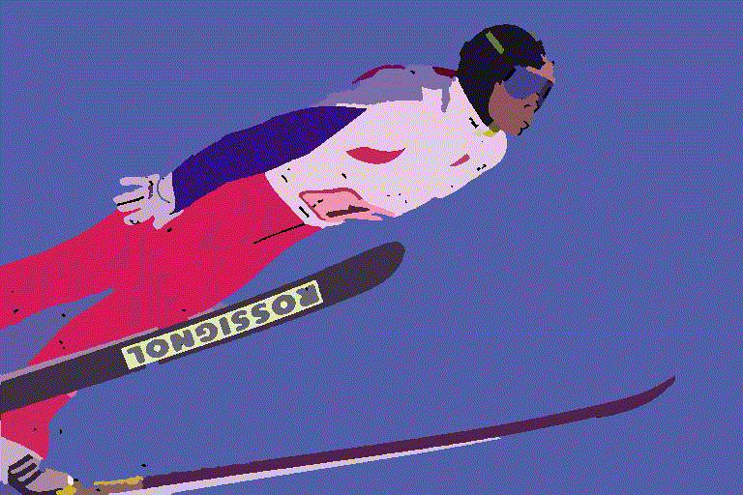
My Proposal
- SVG/XAML text-based search

Slide 16
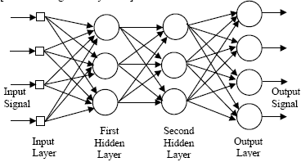
My Proposal
- Neural Networks Approach

Slide 17

Questions…..

